Slide 1
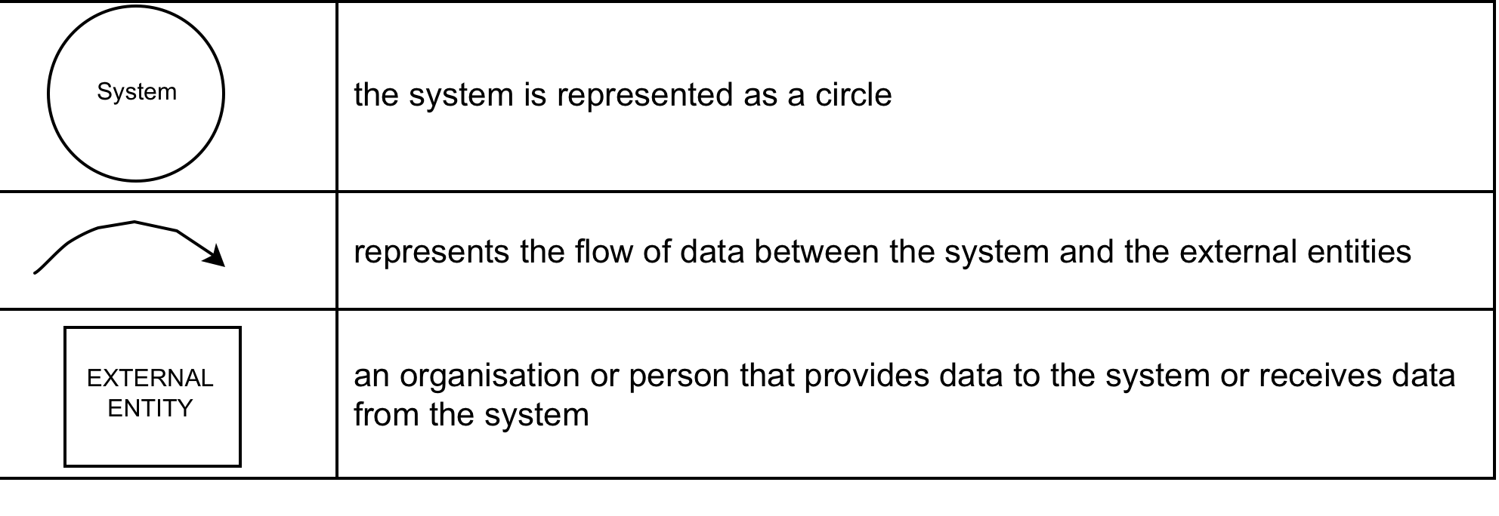
CONTEXT DIAGRAM
is a data flow diagram, with only one massive central process that subsumes everything inside the scope of the system. It shows how the system will receive and send data flows to the external entities involved.

Slide 2
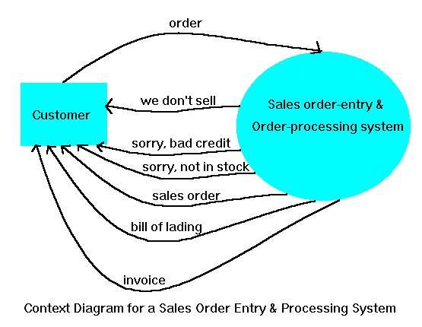

Slide 3
SOCIAL CLUB COMMITTEE
planned activity details
member details
SOCIAL
CLUB
SYSTEM
MEMBER
details confirmation
LOCAL
NEWSPAPER
coming activities description
advertisement details

